Slide 1
Automating Threat Hunting on the Dark Web and other nitty-gritty things

Slide 2
$whoami
Apurv Singh Gautam (@ASG_Sc0rpi0n)
Security Researcher, Threat Intel/Hunting
Cybersecurity @ Georgia Tech
Prior: Research Intern at ICSI, UC Berkeley
Hobbies
Contributing to the security community
Gaming/Streaming (Rainbow 6 Siege)
Hiking, Lockpicking
Social
Twitter - @ASG_Sc0rpi0n
Website – https://apurvsinghgautam.me

Slide 3
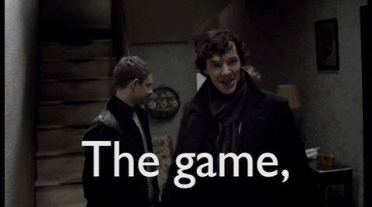
Agenda
Introduction to the Dark Web
Why hunting on the Dark Web?
Methods to hunt on the Dark Web
Can the Dark Web hunting be automated?
Overall Picture
OpSec? What’s that?
Conclusion

Slide 4
1. Introduction to the Dark Web

Slide 5
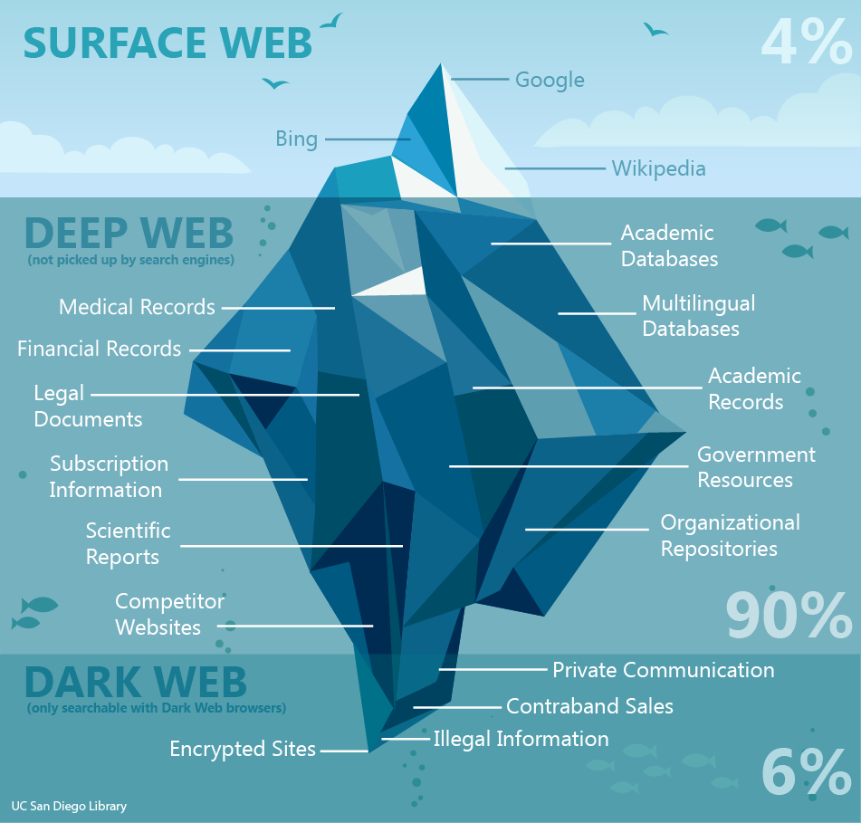
Clear Web? Deep Web? Dark Web?
Image Source: UC San Diego Library
Notes:
Clear web: Sites that are indexed by search engines
Deep web: Sites that are not indexed by search engines
Dark web: Sites that require special software, configuration or authorization to access

Slide 6



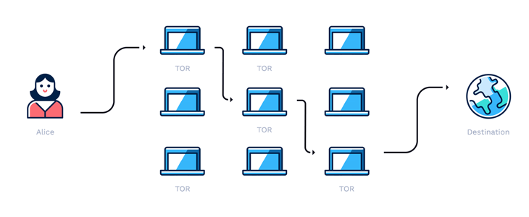
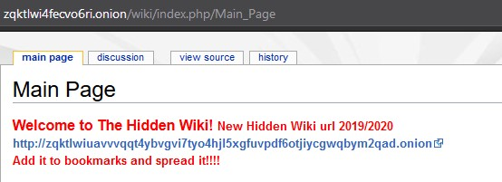
Accessing the Dark Web
Tor /I2P/ZeroNet
.onion domains/.i2p domains
Traffic through relays
Image Sources: Hotspot Shield, Tor Project, I2P Project, ZeroNet
Notes:
The Onion Router/Invisible Internet Project
Alphanumeric
16- or 56-character alphanumeric identifier strings (v2 vs v3 URLS) – v2 – RSA/DH and V3 - ECC
anonymization
Decentralized system
3-layer proxy
Publicly listed entry node, middle relay and exit node (entry nodes doesn’t know the exit node)
Original data encrypted in layers – onion analogy
IP address is hidden
Routes traffic through a series of interconnected volunteer systems called relays (about 6000 relays for Tor)

Slide 7

What’s all the Hype?
Hype
Vast and mysterious part of the Internet
Place for cybercriminals only
Illegal to access the Dark Web
Reality
Few reachable onion domains
Uptime isn’t ideal
Useful for free expression in few countries
Popular sites like Facebook, NYTimes, etc.
Legal to access the Dark Web
Notes:
Dark web is not equal to criminality
Smaller than clear web if compared from availability perspective (uptime)
Tor browser circumvents surveillance – free expression in some countries
Whistleblowing or Activism, safe haven for journalists, access to literature & research
Dark web is many things but not just the vast network of criminals
Home to many other people who don’t want surveillance on them due to their nature of the work
Legal to access dark web but illegal to participate in any illicit business

Slide 8
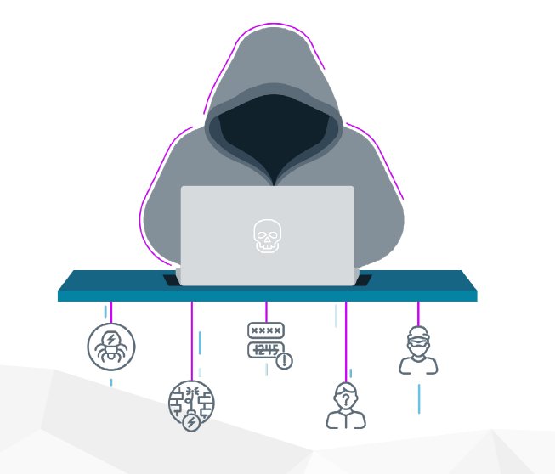
Relevant site types?
General Markets
PII & PHI
Credit Cards
Digital identities
Information Trading
Remote Access
Personal Documents
Electronic Wallets
Insider Threats
Image Source: Intsights
Notes:
Choose your target
Threat Modelling

Slide 9
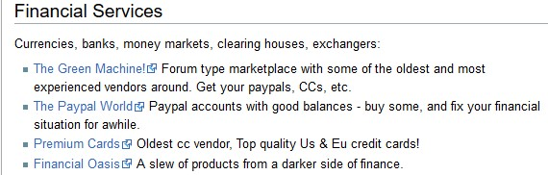
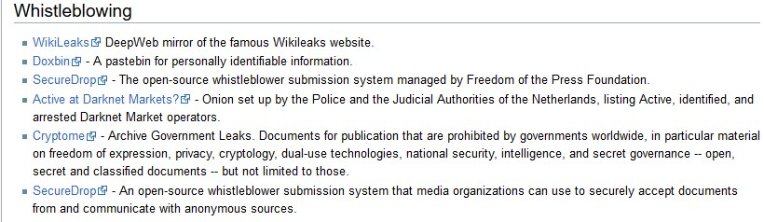
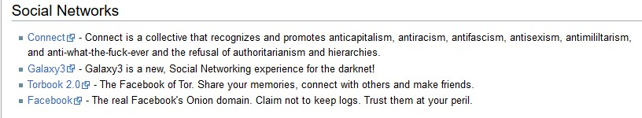
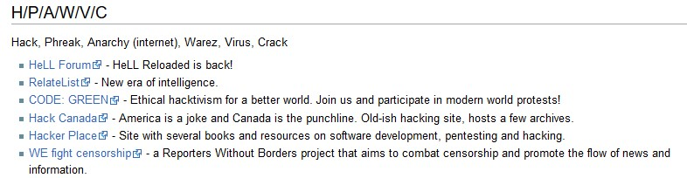
Sites Examples
Notes:
Choose your target
Threat Modelling

Slide 10
Cost of products?
SSN - $1
Fake FB with 15 friends - $1
DDoS Service - $7/hr
Rent a Hacker - $12/hr
Credit Card - $20+
Mobile Malware - $150
Bank Details - $1000+
Exploits or 0-days - $150,000+
Critical databases - $300,000+
Notes:
Recent news
500,000 Zoom accounts sold on dark web
267 million FB User profiles for $540
And many other

Slide 11
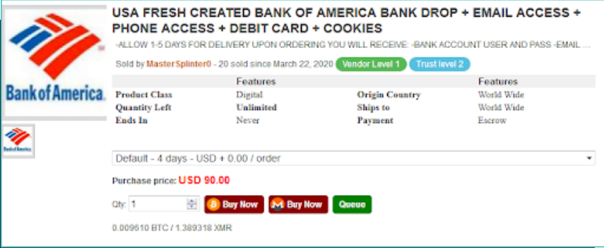
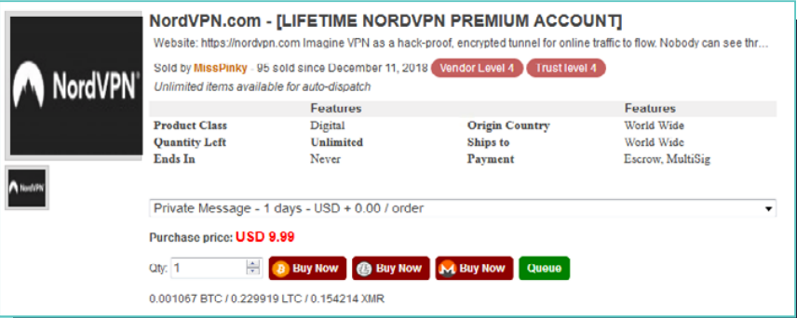
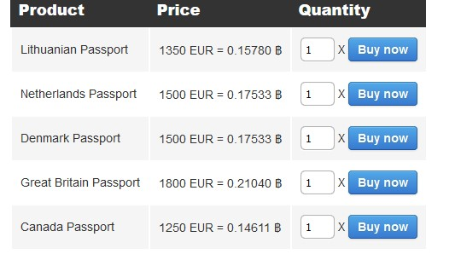
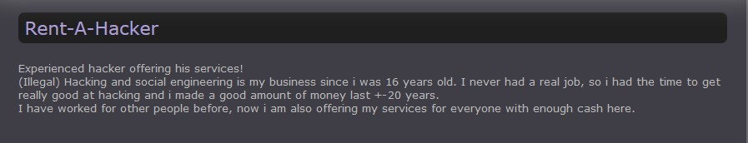
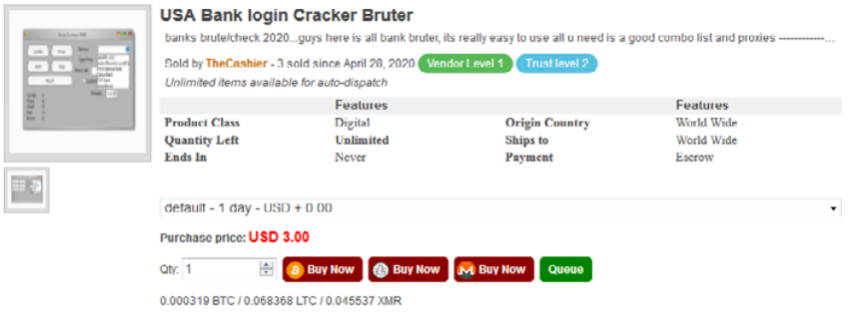
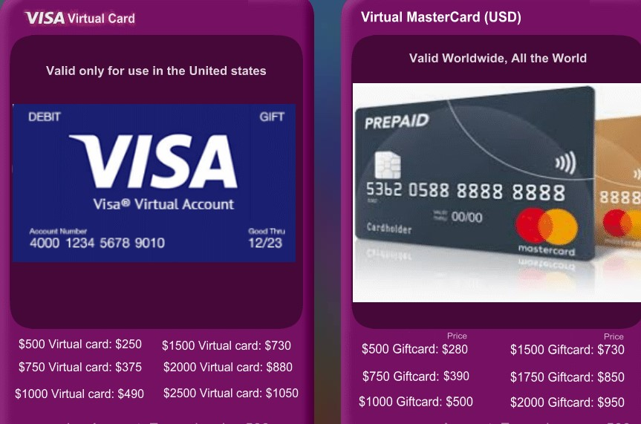
Product Examples

Slide 12
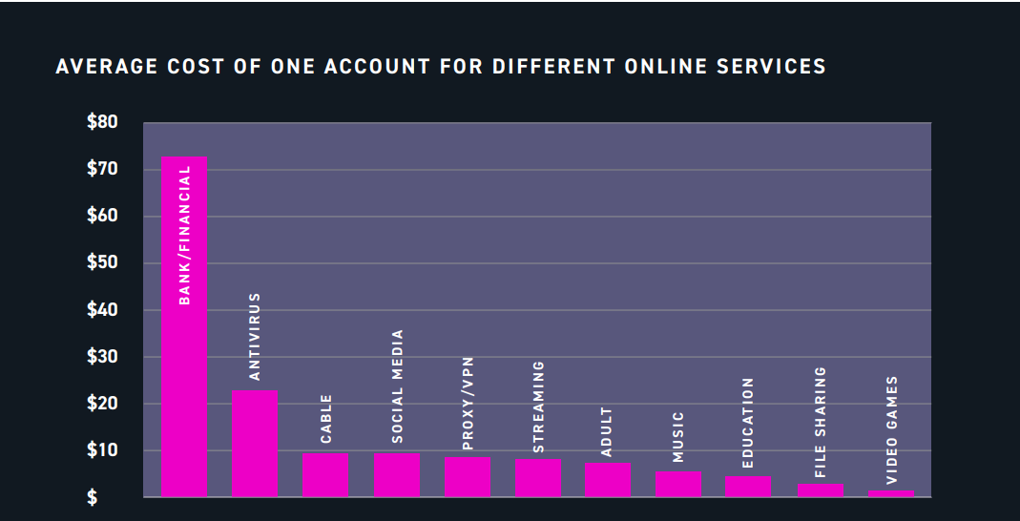
Image Source: Digital Shadows

Slide 13
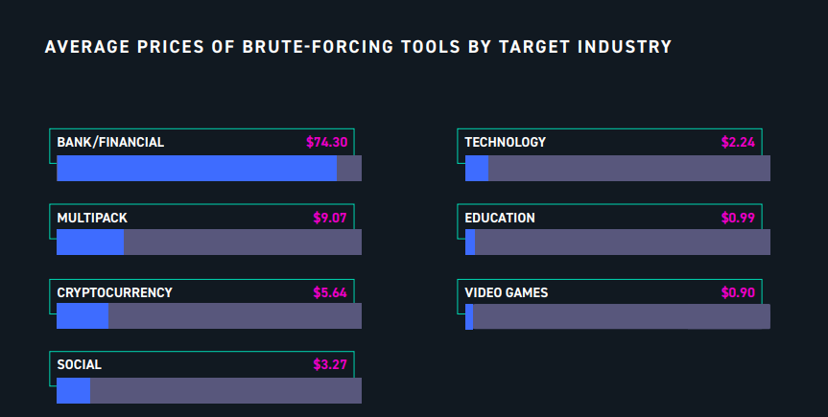
Image Source: Digital Shadows

Slide 14
2. Why hunting on the Dark Web

Slide 15
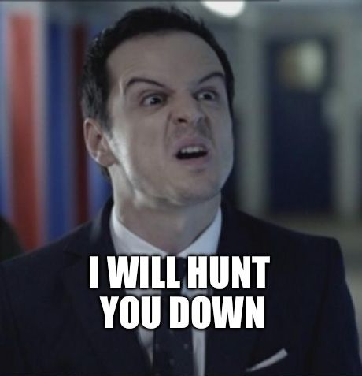
What is Threat Hunting?
Practice of proactively searching for cyber threats
Hypothesis-based approach
Uses advanced analytics and machine learning investigations
Proactive and iterative search
Notes:
Logs, IOCs, textual data, etc.
Nothing concrete about this process
You take one use case and work on that then another and it goes on an on
Choose your target sources – useful for your organization
Threat Modelling

Slide 16

Why So Serious (Eh! Important)?
Hacker forums, darknet markets, dump shops, etc.
Criminals can learn, monetize,
trade, and communicate
Identification of compromised assets
Can potentially identify attacks in
earlier stages
Direct impacts – PII (Personal Info),
financial, EHRs (healthcare records), trade secrets
Indirect impacts – reputation, revenue loss, legal penalties
Notes:
Learn – criminals learn new methods and techniques
Monetize – monetize their skills
Trade – trade their exploits/tools, drugs, weapons
Communicate – communicate with other criminals
Can learn a lot on engaging with these communities
The intelligence from dark web isn’t available anywhere else
Identify attackers,
vulnerability prioritization
in planning and recon stages
Takes a lot of time, If done properly, it can even identify attacks in planning and recon stages

Slide 17
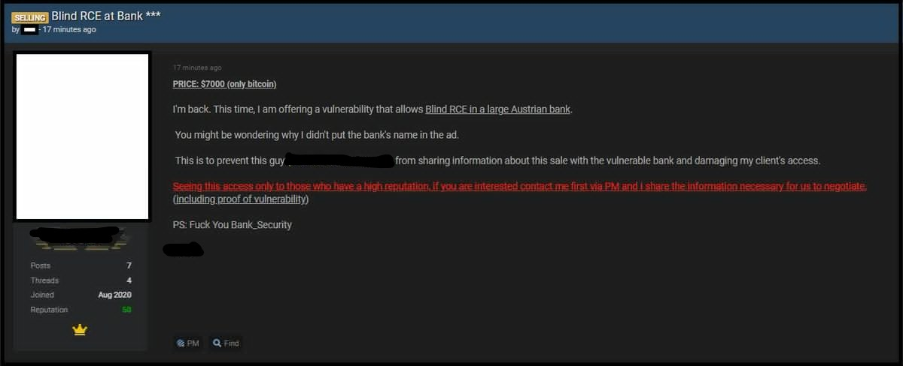
Why you should care?
Notes:
Someone selling RCE of an Australian bank

Slide 18
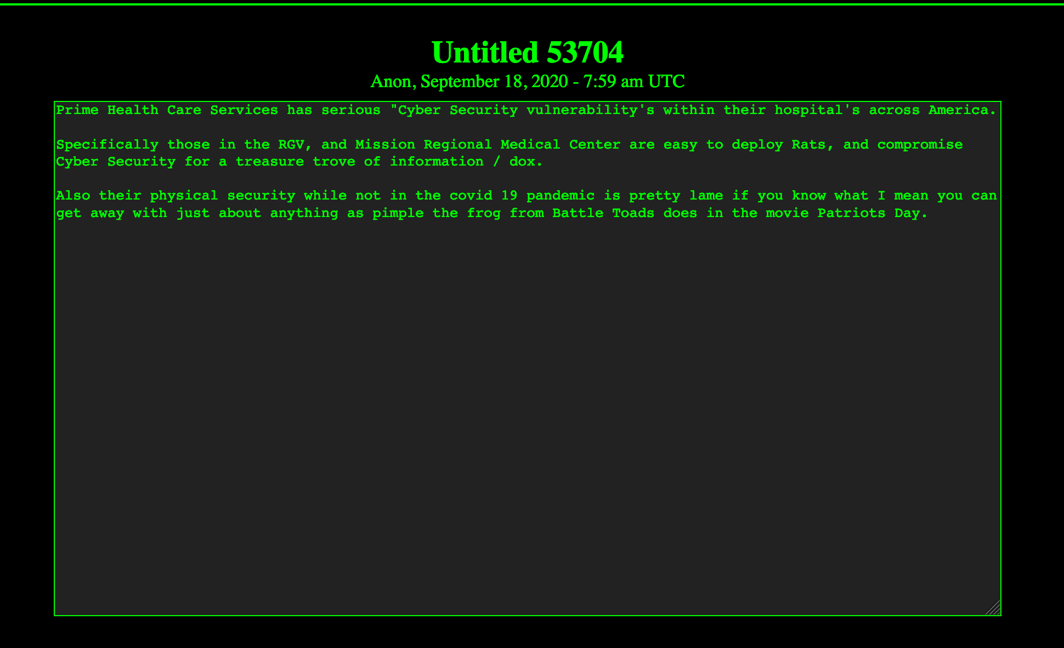
Why you should care?
Notes:
Dark web paste site
Telling about vulnerability in hospitals

Slide 19
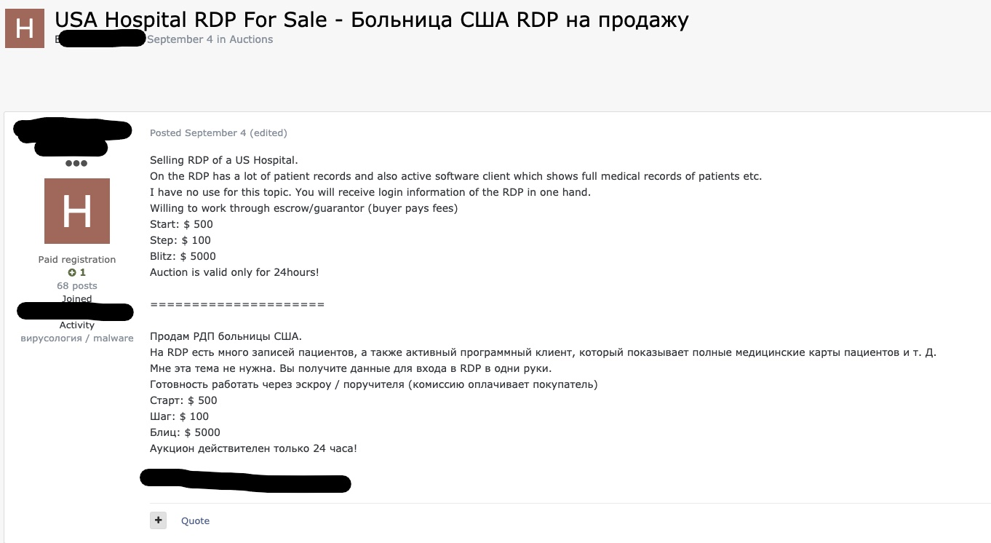
Why you should care?
Notes:
Selling RDP credentials for hospital in US on a Russian forum

Slide 20
Benefits of Threat Hunting
Keep up with the latest trends of attacks
Prepare SOCs/Incident Responders
Get knowledge of TTPs (Tactics, Techniques, Procedures) to be used
Reduce damage and risks to the organization
Notes:
Brand protection
New TTPs
Identifying insider threats
Discover data breaches

Slide 21
3. Methods to hunt on the Dark Web

Slide 22

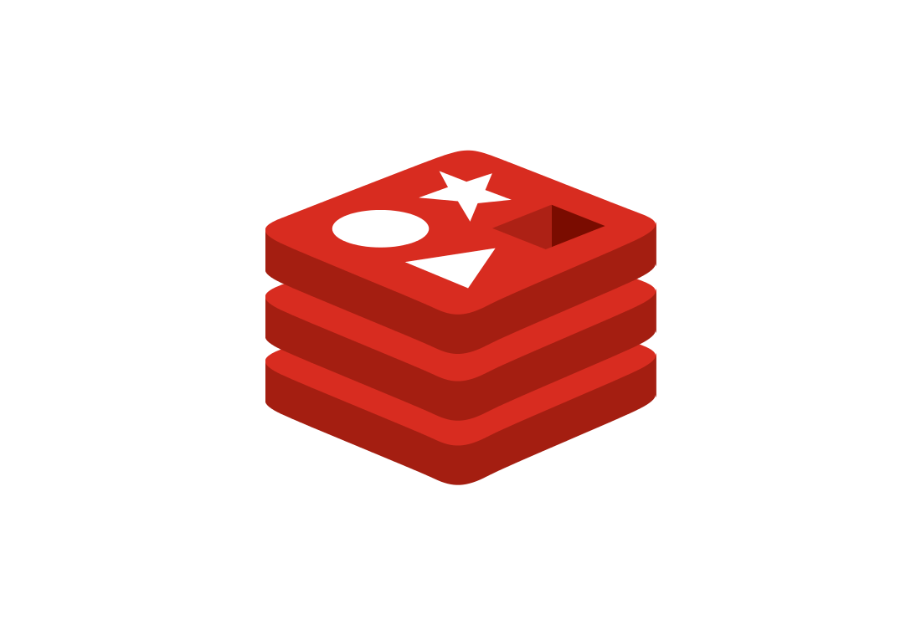



Tools
Scrapy
Tor
OnionScan
Privoxy
Elastic
Redis
and many more…
Image Sources: Tor Project, OnionScan, Scrapy, Privoxy, Redis
Notes:
Scrapy - web-crawling framework - multithreading capability
OnionScan - open source tool for investigating the Dark Web, scanning different onion sites for vulnerabilities, correlations between sites, etc
Different ways of using socks proxy – tsocks, polipo, Privoxy, etc.
Privoxy – web proxy – scrapy cannot use socks proxy so route through Privoxy (tor with socks – layer of protection) - to hide using tor from your ISP
Use VPN + SOCKS for extra protection - hide your activity and get real safe access - can’t trust entry and exit nodes
Redis – in-memory data structure, used as a cache
Torch
Onion Wiki
Search engines like Kilos, Recon

Slide 23
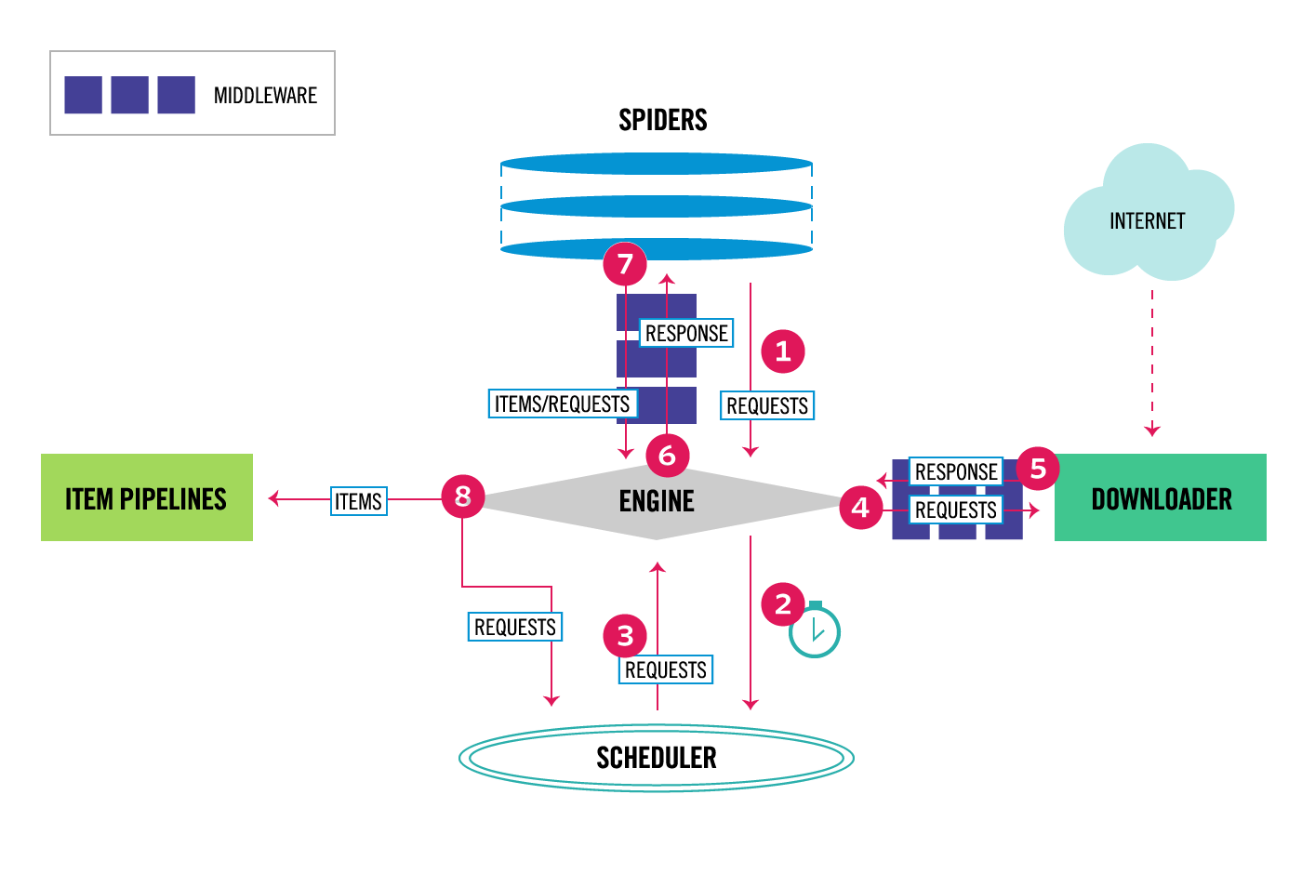
How Scrapy Works?
Image Source: Scrapy Docs
Notes:
1. The Engine gets the initial Requests to crawl from the Spider.
2. The Engine schedules the Requests in the Scheduler and asks for the next Requests to crawl.
3. The Scheduler returns the next Requests to the Engine.
4. The Engine sends the Requests to the Downloader, passing through the Downloader Middlewares
5. Once the page finishes downloading the Downloader generates a Response (with that page) and sends it to the Engine, passing through the Downloader Middlewares
6. The Engine receives the Response from the Downloader and sends it to the Spider for processing, passing through the Spider Middleware
7. The Spider processes the Response and returns scraped items and new Requests (to follow) to the Engine, passing through the Spider Middleware
8. The Engine sends processed items to Item Pipelines, then send processed Requests to the Scheduler and asks for possible next Requests to crawl.
9. The process repeats (from step 1) until there are no more requests from the Scheduler.
Middlewares – ProxyMiddleware(relaying through Privoxy and tor), LoginMiddleware (using user_agent, cookies/bypassing captchas, checking login), Captcha solving websites - deathbycapthca, anticaptcha, etc

Slide 24

HUMINT
Human Intelligence
Most dangerous and difficult form
Most valuable source
Infiltrating forums, markets, etc.
Become one of them
How threat actors think
Can be very risky
Time consuming
Image Source: Intsights
Notes:
Process of gathering intelligence through interpersonal contact and engagement, rather than by technical processes
As attacks are human-driven, to anticipate, Identify and respond to attacks requires human skill and effort
In The Art of War, Chinese military strategist Sun Tzu wrote: “To know your Enemy, you must become your Enemy.”
Understanding the motives and tendencies behind your adversaries is a key to any type of warfare, including cyber warfare
It’s the high-tech equivalent of what an undercover FBI agent does when he or she spends months or years working to infiltrate a criminal organization.
Using HUMINT to bolster Threat Hunting – Post Attack Investigation, New Attack Vector Discovery, etc

Slide 25
4. Can Dark Web hunting be Automated?

Slide 26
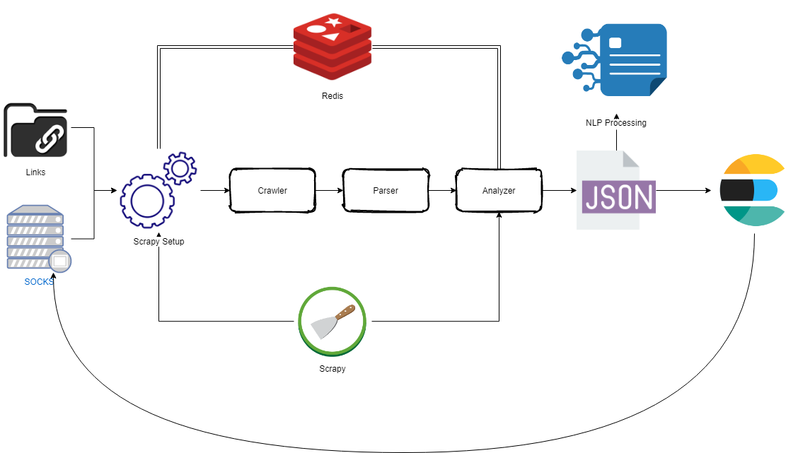
Automated Hunting Architecture
Notes:
Dark web links – collect forum/DNMs links
Tools like OnionIngestor – collect onion links from various sources
Socks proxies – run socks proxy script to collect several socks proxies to route tor through them
Different crawlers for different forums
Scrapy setup – setup login for each forum, setup several settings including headers, cookies, ignored links, captcha bypass, etc
Talk about captcha bypass (captcha solving services like deathbycapthca, anticaptcha, etc.)
Crawler - crawls html pages of the forums
Parser – parses html pages (taking only relevant texts from the html) – post_id, post_content, post_author, author_status, reputation, item_price, etc.
Analyzer – uses NLP techniques to evaluate the content that is relevant to the threat model and stores them into the ES database.
Design/Train NLP model – design and train NLP model on the content that is relevant to your threat model and apply it on new data
Egg and chicken problem (data gathering vs training on data)
Many unsupervised learning models – lda, seeded lda, etc.

Slide 27
5. Overall Picture

Slide 28
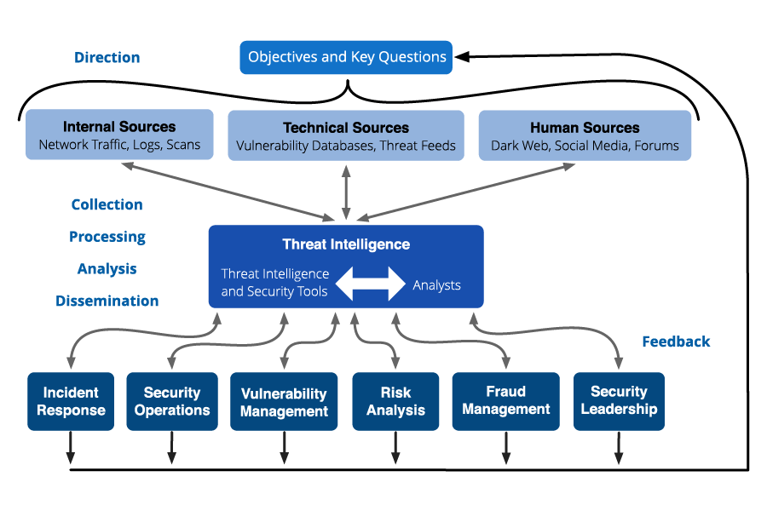
Let’s talk about TI Lifecycle
Image Source: Recorded Future
Notes:
Direction - identify dark web forums, acquire access
Collection - establish anonymous access, collect raw data
Processing - parsing raw HTML data, machine translation, extract topics and authors
Analysis - infer relationships , link data sources, identify trends, hacks and leaks
Dissemination - visualization in dashboards, alerts and reports

Slide 29
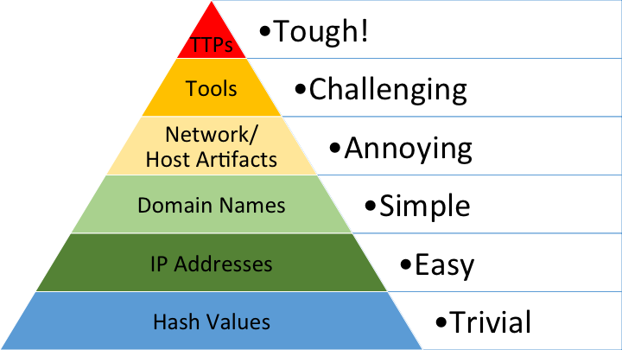
Threat Modelling
“works to identify, communicate, and understand threats and mitigations within the context of protecting something of value” – OWASP
Define critical assets
Understand what attackers want
Threat actor capability and intent
Sources to target
Image Source: David Bianco
Notes:
Critical assets - databases holding customer data, payment processing systems, employee access systems, trading platforms or exchanges, or Enterprise Resource Planning (ERP) applications
Threat actor capability & intent – define types of actors like hacktivists, insiders, criminal groups, etc. and know their capability.
Consider why an attacker wants to target your organization? What do they hope to gain? What are their goals?
Chose your target on dark web - which site do you want to go for – credit card markets, insider threats market, general markets, etc.
Prioritize risks – use pyramid of pain for that - IOCs
Chose on clear web – sites like pastebin, twitter, etc.

Slide 30
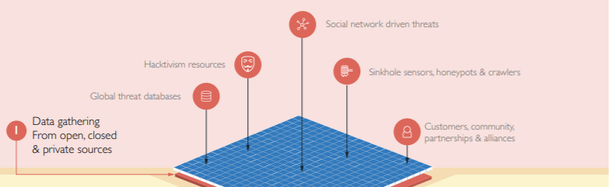
Data Collection/Processing
Collecting data from clear web
Pastebin
Twitter
Reddit
Telegram
Collecting data from dark web
Forums
Markets
Image Source: Blueliv
Notes:
Crawler and Parser

Slide 31

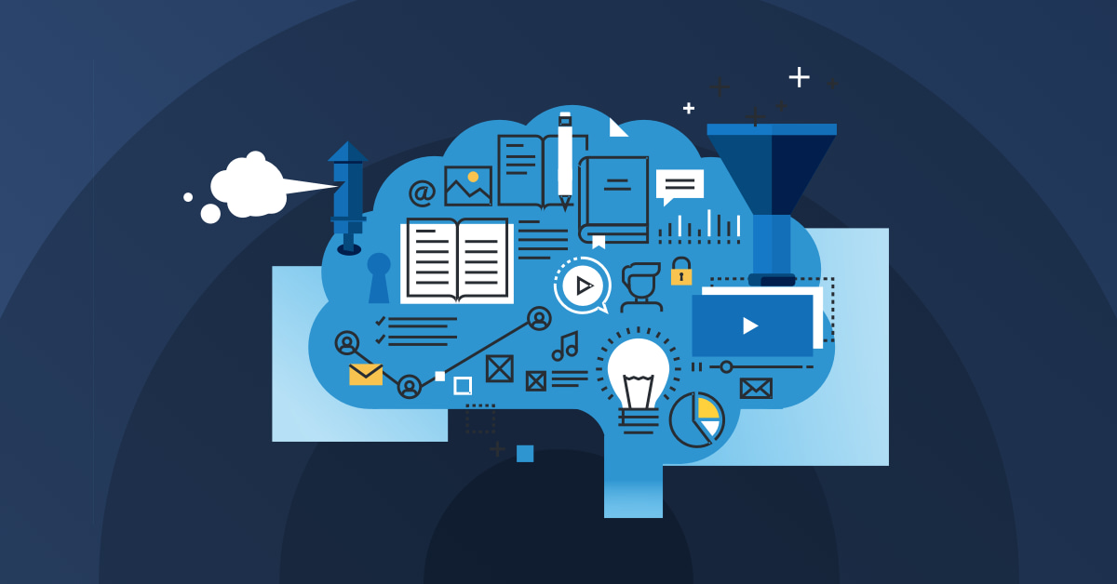
Data Analysis
NLP/ML/DL techniques
Social network analysis
Classification
Clustering
MITRE ATT&CK
Image Sources: DataCamp, MITRE ATT&CK
Notes:
NLP techniques – LDA, BERT, GPT, GPT-2, GPT-3
Social network analysis – analysis of the users
Classification – binary or multi-class classification
Clustering – clustering of products according to categories
Services provided by different companies or code your system from ground up
MITRE ATT&CK - knowledge base of adversary tactics and techniques (TTPs) based on real-world observations.
Use ATT&CK matrix to map the intelligence you obtained to better understand the TTPs

Slide 32
6. OpSec? What’s that?

Slide 33
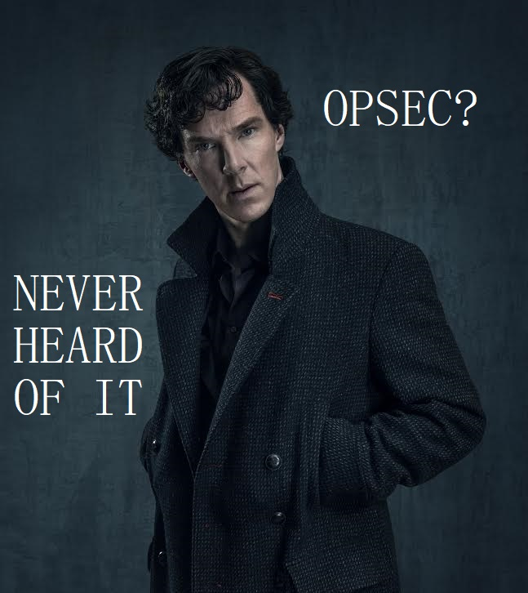
What is OpSec?
Actions taken to ensure that information leakage doesn’t compromise you or your operations
Derived from US military – Operational Security
PII – Personally Identifiable Information
Not just a process – a mindset
OpSec is Hard
Notes:
the practice of hiding yourself online by disassociating your online persona with your real self
We are all humans
We desire to be seen knowledgeable and to impress others
Leads to gossip, brag, and overshare
PII – personal information that can identify you – full name, SSN, driver’s license, bank account, email, passport number, etc.

Slide 34

Maintaining OpSec in your lifestyle
Use VM/Lab or an isolated system
Use Tor over SOCKS or VPN
Change Time zones
Never talk about your work
Maintain different persona
Take extensive notes
Use password manager
Notes:
You have to do opsec from the beginning/proactivly because you can't do opsec "retroactively"
Never store any personal information on the VM or the system you are accessing dark web from
Clean/Wipe all the data before leaving the system and start fresh the other day
Watch what you say to whom and where
Think before you post
Have different persona on different sites, don’t mix it., Have a back story for each personas
Take notes so you don’t mess up the personas
It’s a 24x7 thing to do and not during your job duration
You can’t work 9-5 as that would be a tip off that you are not a threat actor.
Develop appropriate language skills and slang skills

Slide 35
7. Conclusion

Slide 36
What we discussed so far?
Little about the Dark Web
Dark Web forums/marketplaces
Dark Web threat hunting
Scrapy
HUMINT
Automating the Dark Web hunting
Little about threat intelligence lifecycle
OpSec

Slide 37
If you take one thing from this talk,
Figure out your assets
Create hunting pipeline (Scrapy, ELK, Redis, etc.)
Start Scrapy and put your data into ELK
Search for your company’s name in Kibana
If found -> Analyze the results
Do this on a monthly basis with different terms
Report to your team through intelligence briefing

Slide 38
I don’t know how to conclude but..
Dark Web threat hunting is hard but worth the effort
Keep OpSec in mind
Look at more than one resource
Takes a lot of resources and team effort
Usage of MITRE ATT&CK framework
Notes:
You don’t get the intelligence from anywhere else
Look at more forums

Slide 39
Resources
Blogs & White papers by Recorded Future
White papers by IntSights
Blogs by Palo Alto’s Unit 42
Blogs by CrowdStrike
White papers by Digital Shadows
Darkweb Cyber Threat Intelligence Mining by Cambridge University Press
Ambly the Smart Darknet Spider talk by Cytisus Eurydice (@levitannin)

Slide 40

Thanks!
Any questions?
You can contact me at:
Twitter: @ASG_Sc0rpi0n
LinkedIn: /in/apurvsinghgautam

